Slide 1

[3]
Controlling a Vectored
Thrust Aircraft
By Tyler Freitas
ME547 student
University of Washington
Seattle, WA, USA
tfreita@uw.edu

Slide 2
Introduction
Existing Aircraft Motion Control
Harrier Jump Jet - Vertical Takeoff and Landing (VTOL)
Examples of Positional Stability Controllers:
1. Linear-Quadratic Regulator (LQR) [1]
2. Nonlinear State-Feedback [2]
Harrier Jump Jet [3]
Harrier Jump Jet Video [3]
https://video-alexanderstreet-com.offcampus.lib.washington.edu/watch/the-harrier-jump-jet/clips/181690

Slide 3
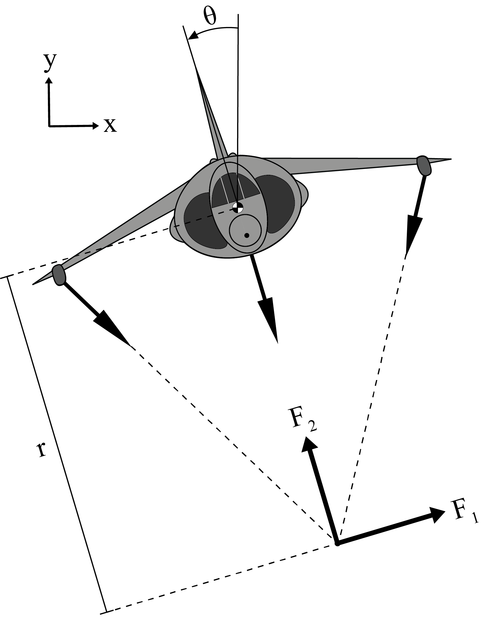
Problem Formulation: Model
Plant:
Vectored Thrust Aircraft (2D Rigid Body) with 3 thrusters
Input:
Reaction forces (F₁,F₂) of the thrusters on the aircraft
Output:
Aircraft’s Position (X, Y) and Orientation (θ)
Note:
Reaction forces of thrusters are translated to a common intersection point
r is the distance from the aircraft centroid to the thrusters' intersection.
The simulation only covers the Aircraft’s Position (X, Y)
2D Plant Free-Body Diagram
Note: not to scale

Slide 4
Problem Formulation: Physics
Aerodynamic Forces: (Newton’s 2nd Law, F = ma)
Lift/Thrust – Thruster Reactions on Aircraft (Newton’s 3rd Law)
Weight – Aircraft Mass
Drag – Air Resistance & Thruster Reactions on Aircraft in Drag direction
Assumptions:
No Air Torque Resistance
Small Angle Approximation
Hovering Aircraft
Same Angles Changes of the Wingtip Thrusters

Slide 5
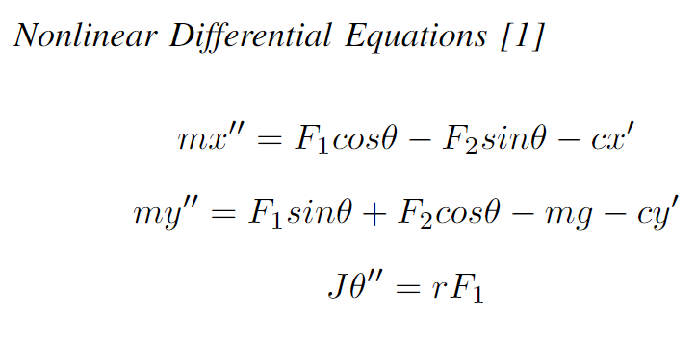
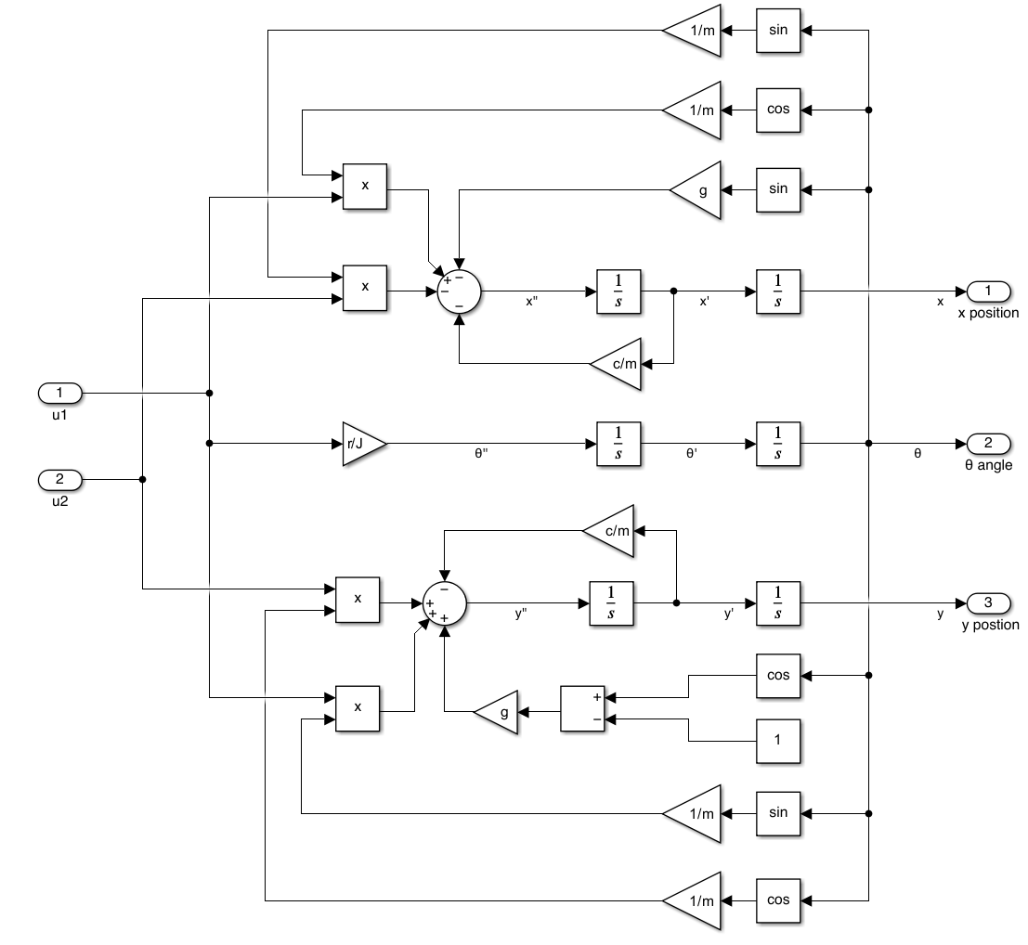
Problem Formulation: Physics Cont’d
Mathematical Variables:
F₁ - aircraft horizontal reaction
F₂ - aircraft vertical reaction
J - moment of inertia
c - damping coefficient
g - acceleration due to gravity
m - aircraft mass
x - aircraft horizontal position
x′ - aircraft horizontal velocity
x′′ - aircraft horizontal acceleration
y - aircraft vertical position
y′ - aircraft vertical velocity
y′′- aircraft vertical acceleration
θ - aircraft angular position
θ′′ - aircraft angular acceleration
r - length from aircraft centroid to thrusters' intersection
[1]
Nonlinear Block Diagram

Slide 6
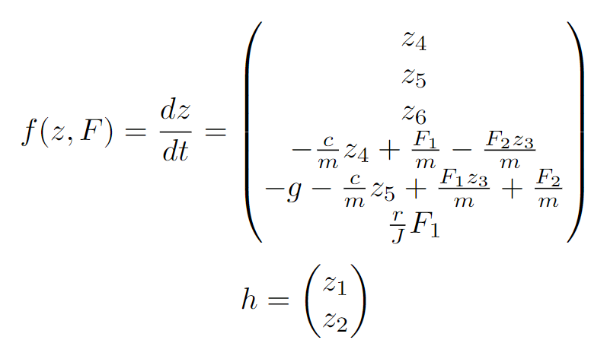
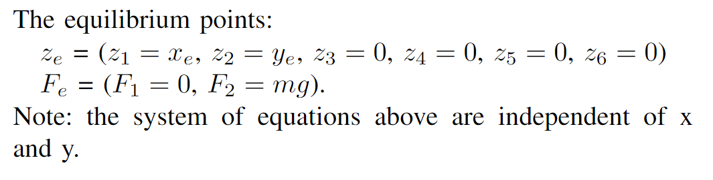
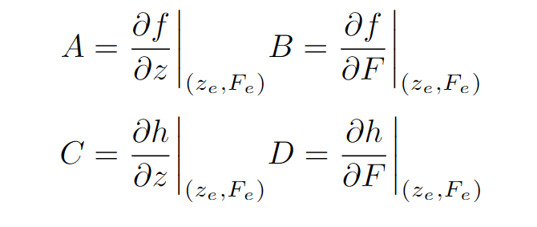
Analysis: Nonlinear State Space Model
More Analysis Variables:
y_{e} - y equilibrium point
x_{e} - x equilibrium point
z_{e} - state-space equilibrium points
F_{e} - input equilibrium points
A, B, C, D - state-space matrices
ζ - linearized state-space variable
v - linearized state-space input
R - linearized state-space output
z - nonlinear state-space variable
f - time derivative of z
h - nonlinear state-space output
F - nonlinear state-space input
[1]

Slide 7
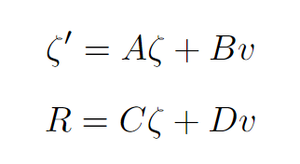
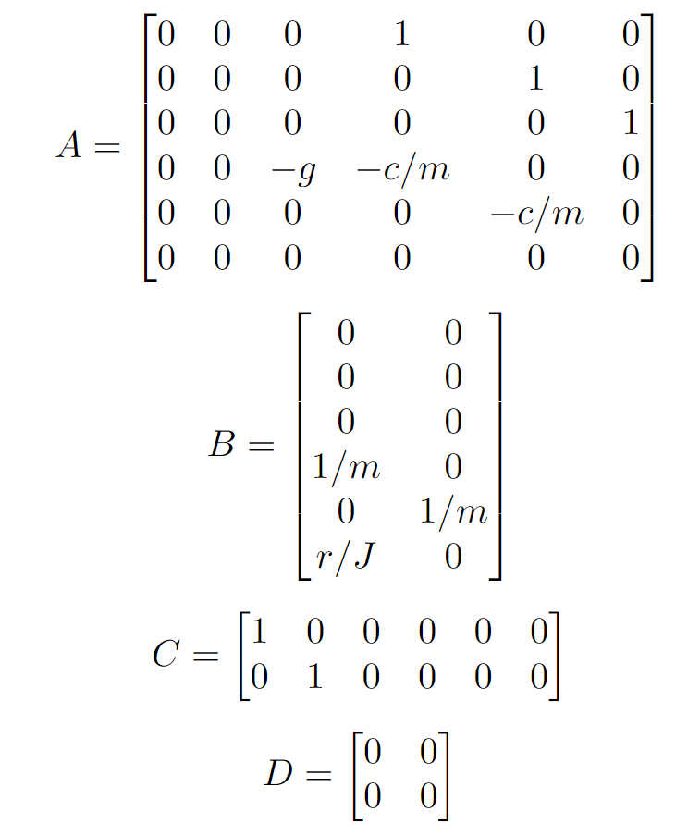
Analysis: Jacobian Linearization
Jacobian Matrices [1]
Nonlinear State-Space System & Equilibrium Points [1]
Linearized State-Space System [1]

Slide 8
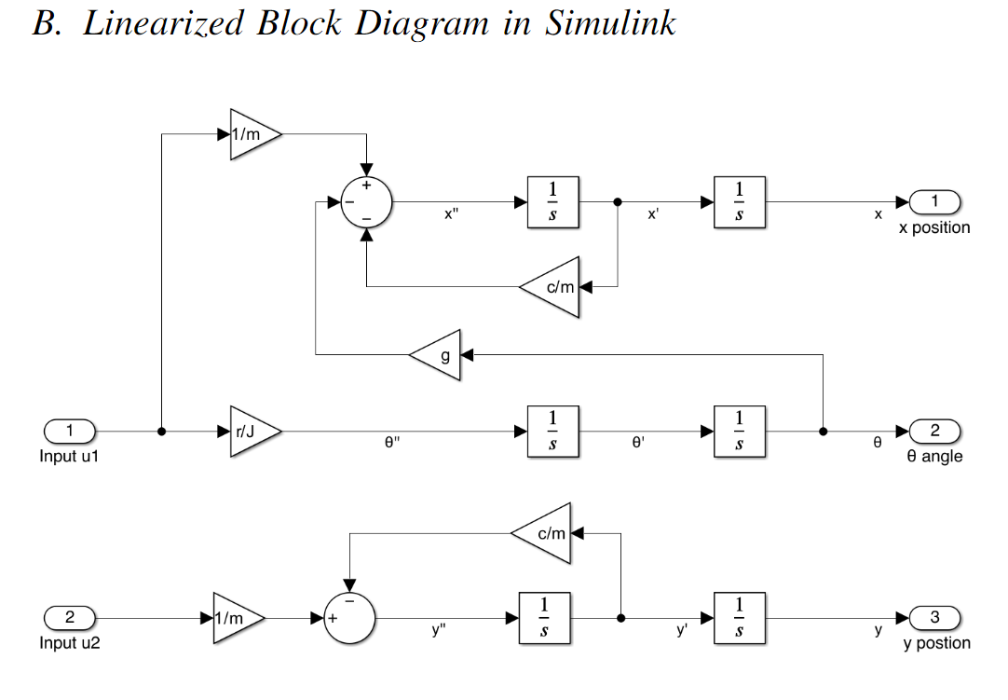
Analysis: Linearized System Forms
Linearized Block Diagram
Note: u1 = F₁ & u2 = F₂ (dummy variables)
Linearized State-Space System [1]

Slide 9
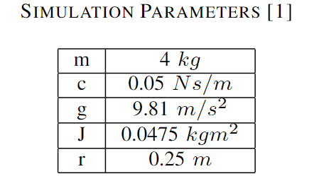

Numerical Analysis & Simulation Parameters
Numerical Analysis Variables:
G₁ - Local x transfer function
G₂ - Local y transfer function
I - Identity Matrix
u - eigenvectors
λ - eigenvalues
J_{A}, J_{B} , J_{C} , J_{D} - Jordan Form state-space matrices
V_{g} - Generalized Eigenvectors matrix
β - Similar Transform Variable
∆t - Sampling time
Q - Positive Definite Identity matrix
P - Lyapunov Symmetric Matrix
V - Lyapunov Function
K - State-Feedback Controller Parameter
L - Observer Controller Parameter
A_{obs}, B_{obs}, C_{obs}, D_{obs} - Observable Canonical matrices
A_{d}, B_{d}, C_{d}, D_{d} - Discrete state-space matrices
A_{ctrl}, B_{ctrl}, C_{ctrl}, D_{ctrl} - Controllable Canonical matrices
K_{obs} - Observer State-Feedback Parameter
ω - Sampling frequency
Simulation System Parameters

Slide 10
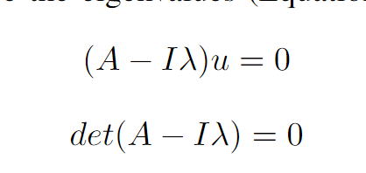



Eigenvalue & Lyapunov Stability
Eigenvalue Stability
Multiple Eigenvalues at the origin conclude that the system is not asymptotically stable.
Lyapunov Stability: (Q = I)
No unique P, thus not asymptotically stable at the equilibrium point.
System Eigenvalues
Eigenvalue equations
Lyapunov Function
Lyapunov Equation

Slide 11
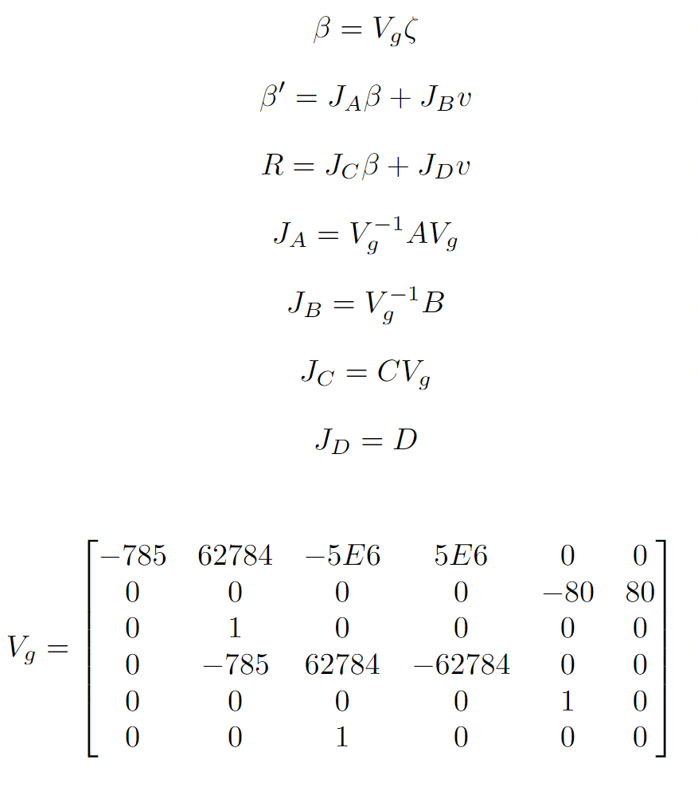
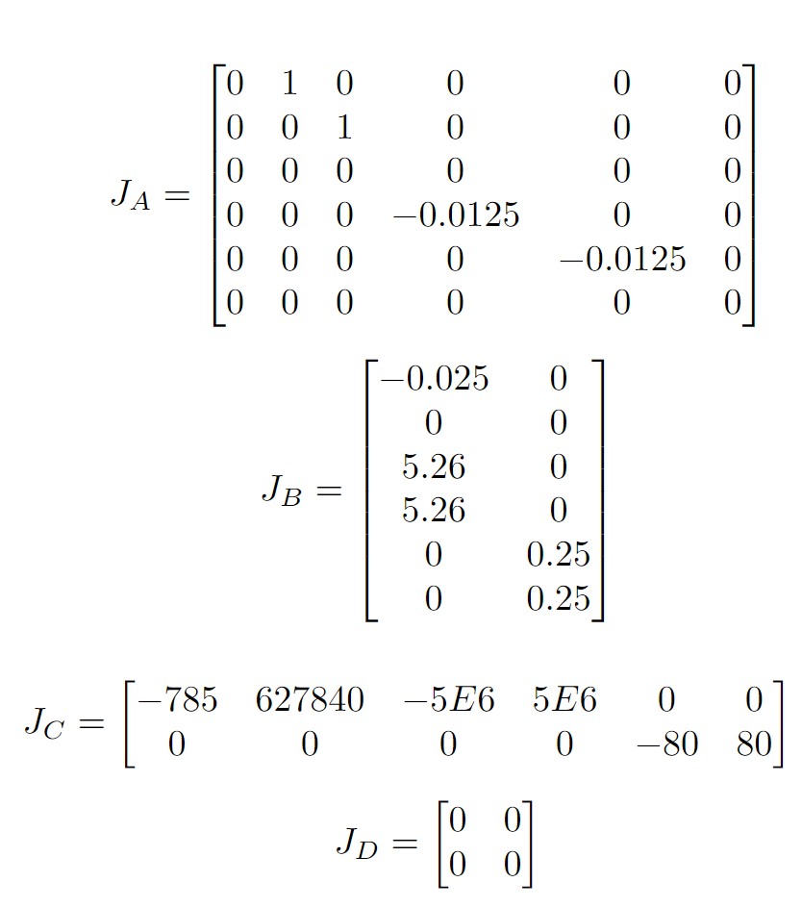
Jordan Form
Converted Linearized Jacobian Matrices to Jordan Form
Note: β is the Similar Transform Variable
Eigenvalues & Generalized Eigenvalues Matrix

Slide 12
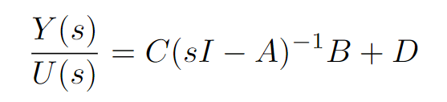
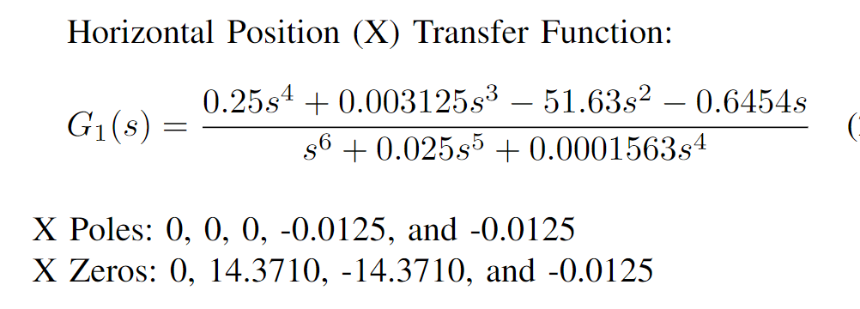
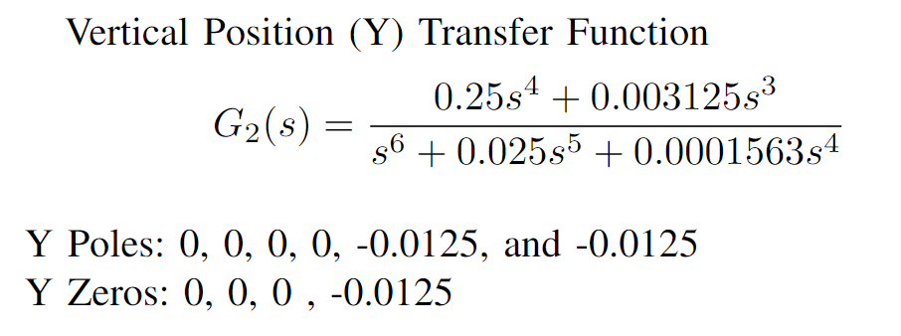
Transfer functions
Converted Linearized Jacobian Matrices to Transfer Functions
State-Space System to Transfer Function
Linearized Transfer Function with Poles & Zeros
Notes:
1. No Initial conditions
1. F₁ is the only input for Local X dynamics
2. F₂ is the only input for Local Y dynamics

Slide 13
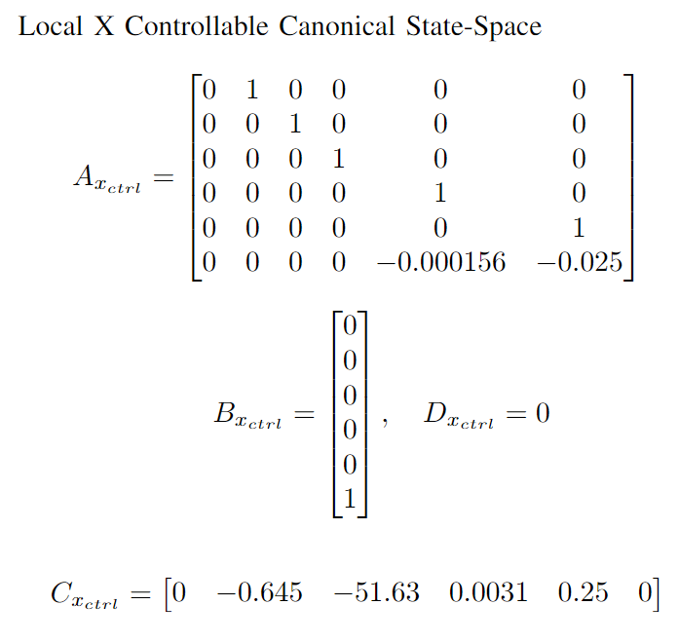
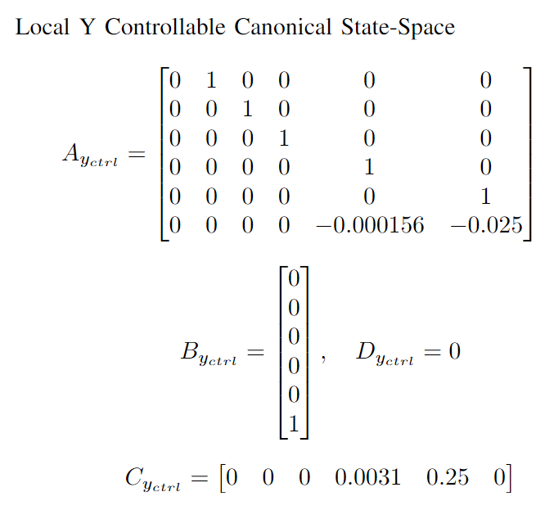
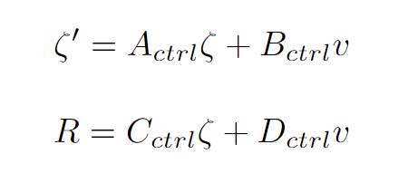
Controllable Canonical Form
Converted Linearized Jacobian Matrices to Controllable Canonical Form

Slide 14
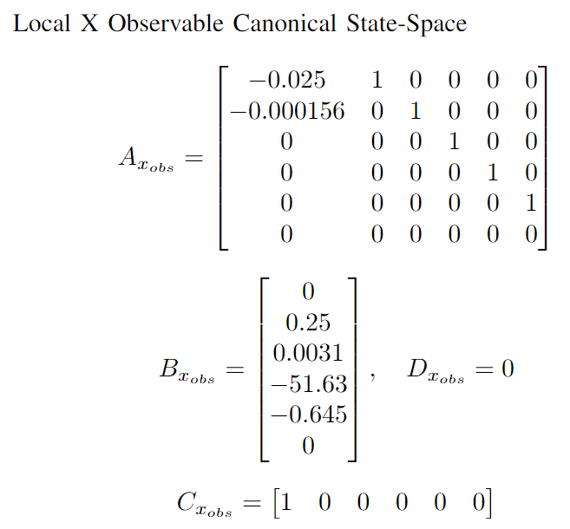
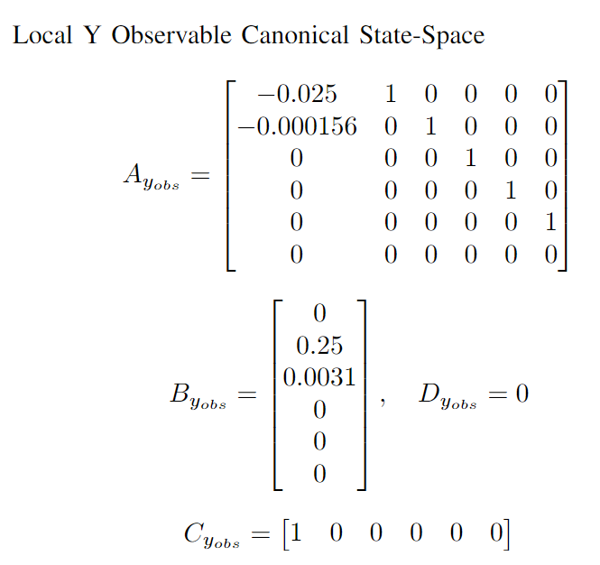
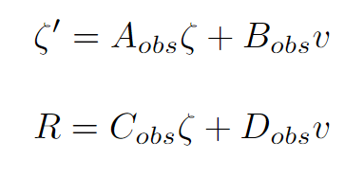
Observable Canonical Form
Converted Linearized Jacobian Matrices to Observable Canonical Form

Slide 15
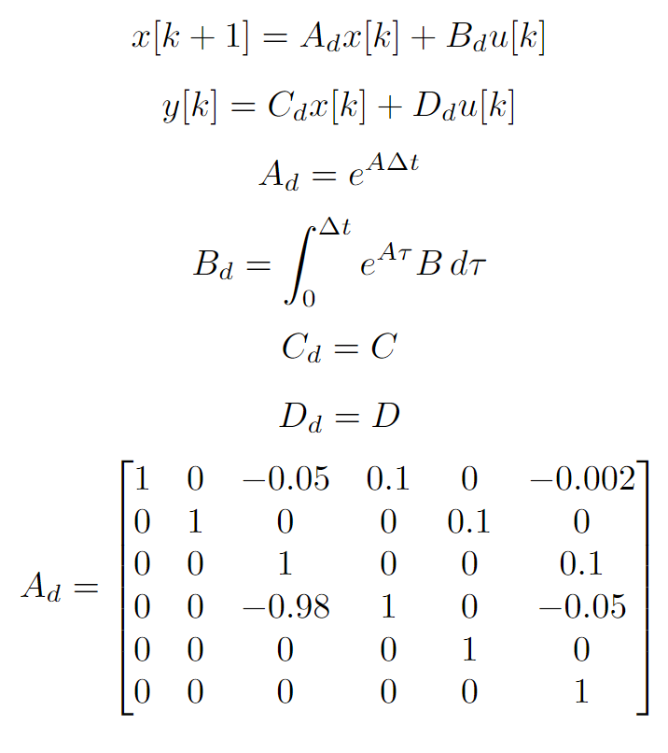
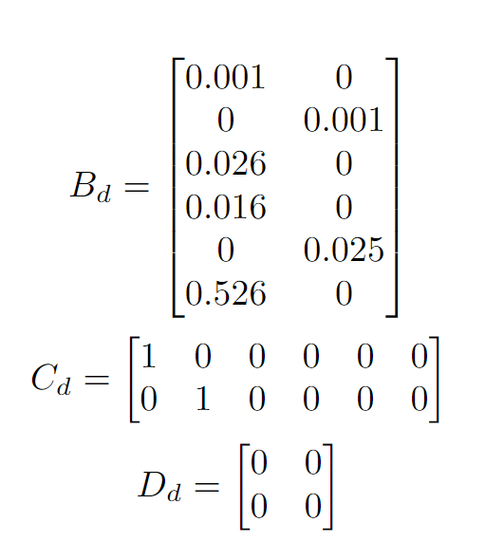

Discrete State-Space
Converted Linearized Jacobian Matrices to Discrete State-Space
Eigenvalues of A_{d}

Slide 16
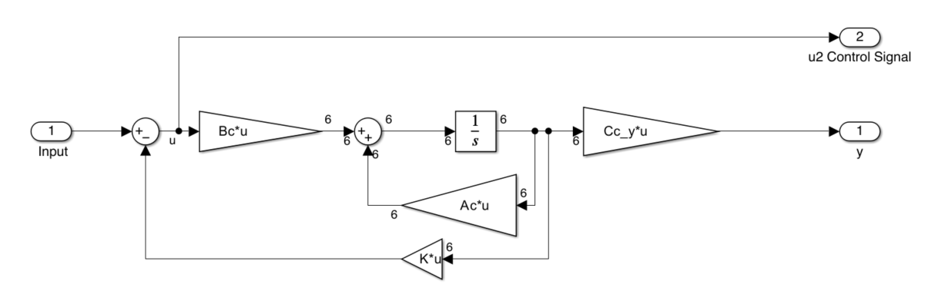
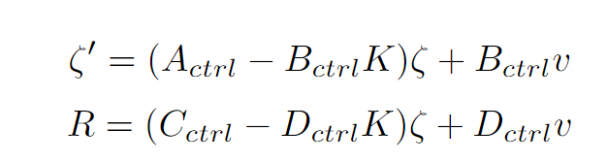

State-Feedback Controller
Added a State-Feedback Controller to Controllable Canonical Form
State-Feedback Controller Block Diagram for Local Y
State-Feedback Gain
Note: Local X has a similar Block Diagram
Note: Same K for Local X & Y responses
Desired Closed-Loop State-Feedback Eigenvalues/Poles:
Complex dominant poles are close to the origin
Adjacent poles are at least 5x farther from the complex dominant poles
The real part of these eigenvalues are negative for stability

Slide 17
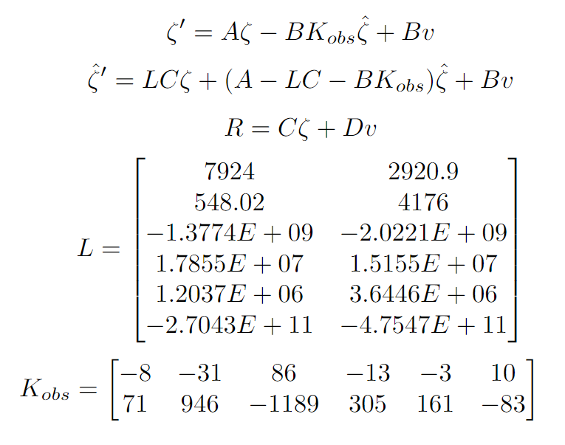
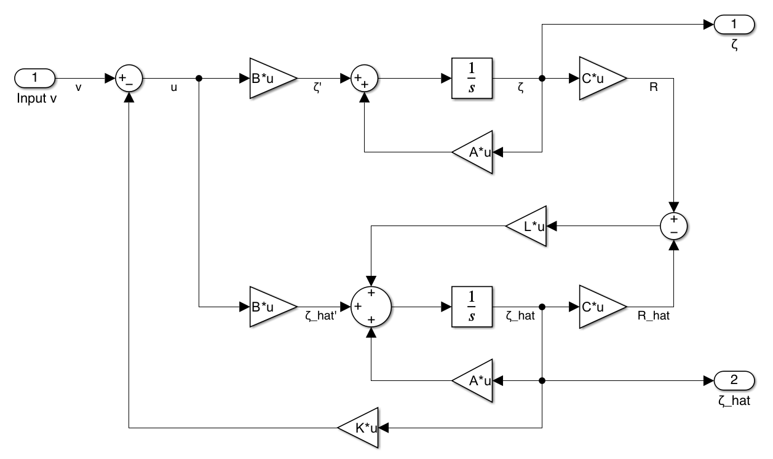
Observer State-Feedback Control
Added an Observer State-Feedback Controller to the Jacobian Matrices
Same Closed-Loop State-Feedback Eigenvalues
Desired Closed-Loop Observer Eigenvalues/Poles:
First Observer pole is at least 5x farther from the farthest State-Feedback pole
Have complex dominant poles
Observer adjacent poles are 5x farther from its complex dominant poles
The real part of these eigenvalues are negative for stability
Poles are far away from the origin for faster dynamics

Slide 18
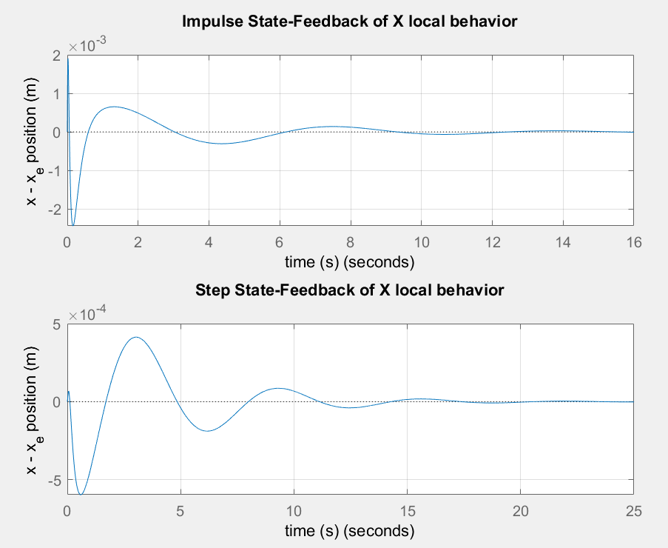
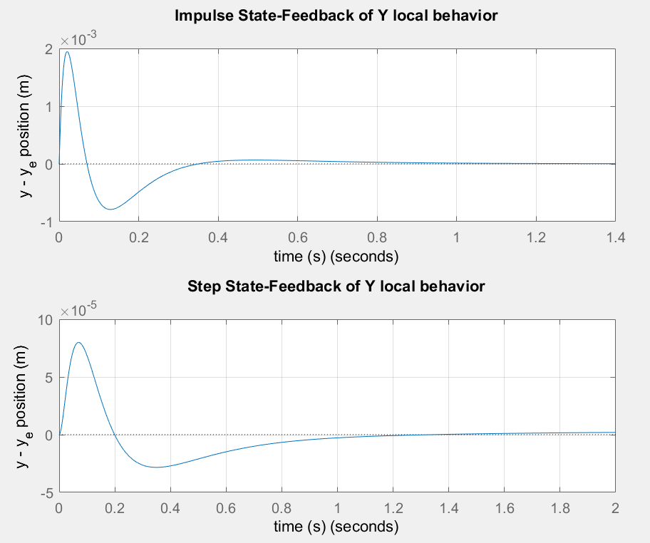
Results: State-Feedback Step/Impulse

Slide 19
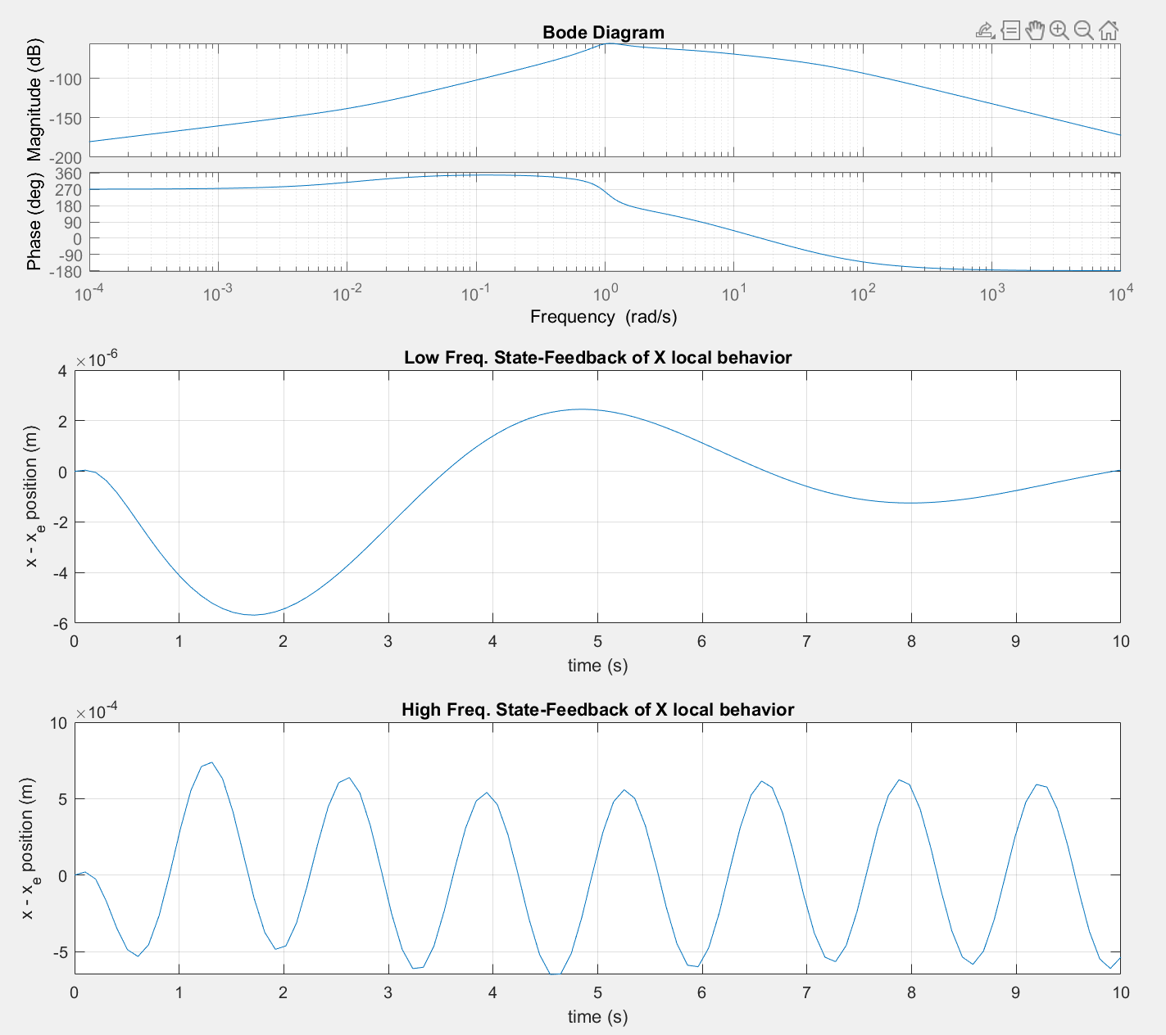
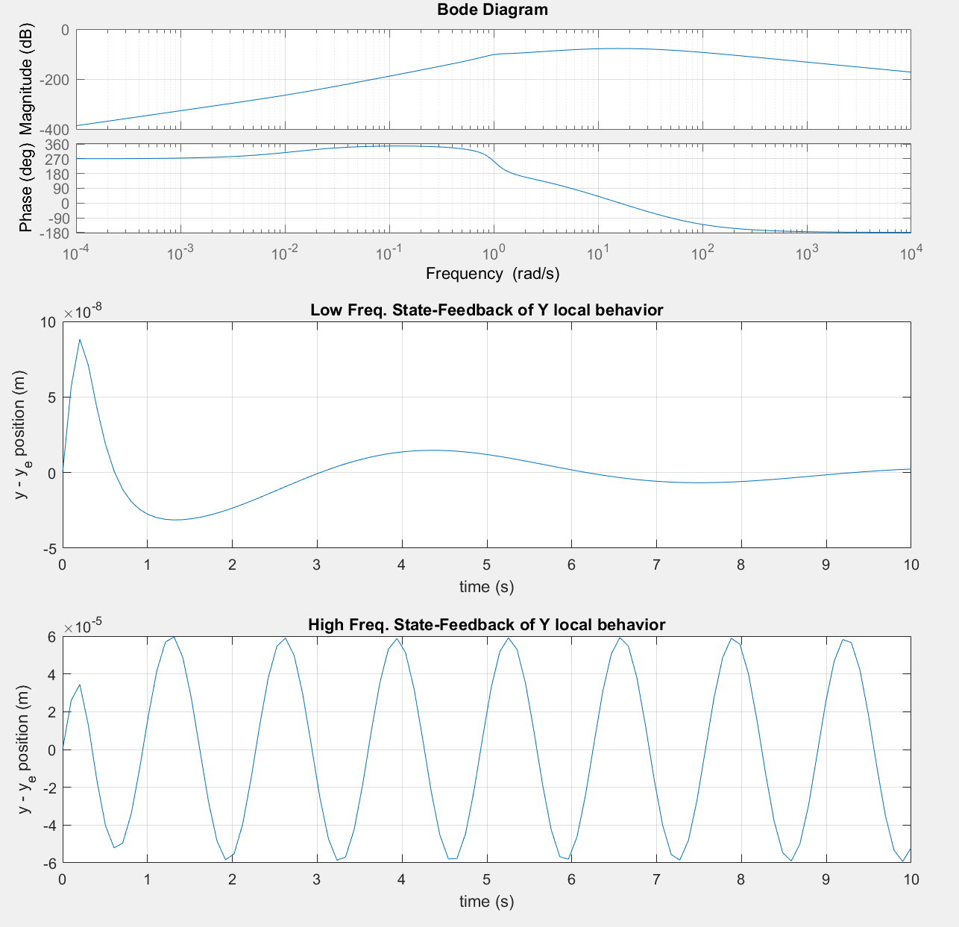
Results: State-Feedback High/Low Freq. Sine

Slide 20
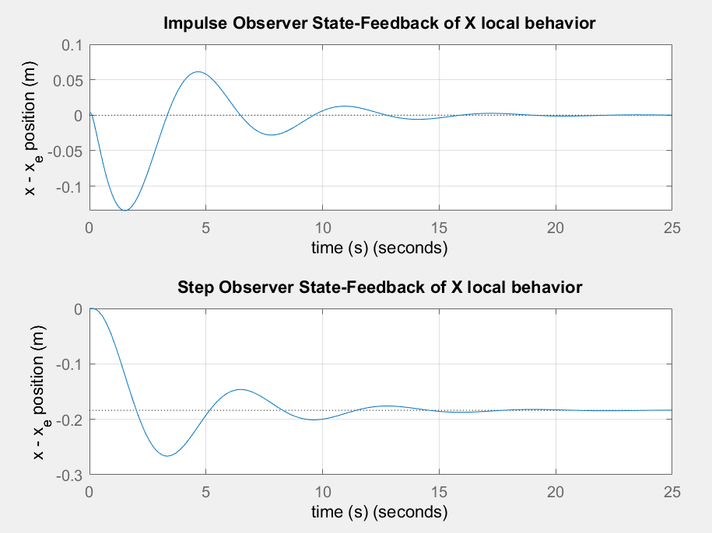
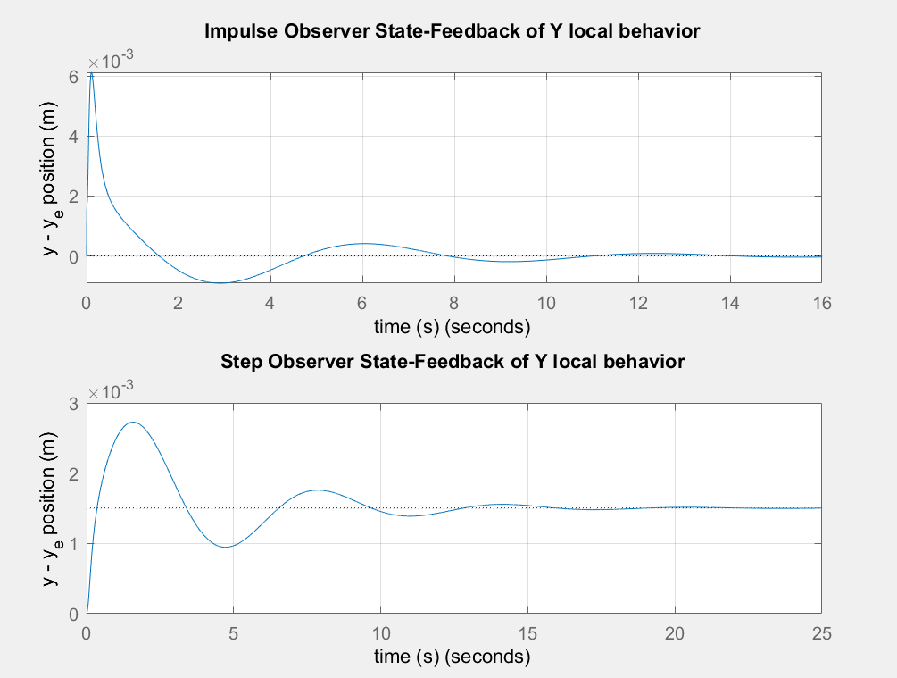
Results: Observer State-Feedback Step/Impulse
Note: Plant and Observer have no initial conditions, therefore the responses are the same.

Slide 21
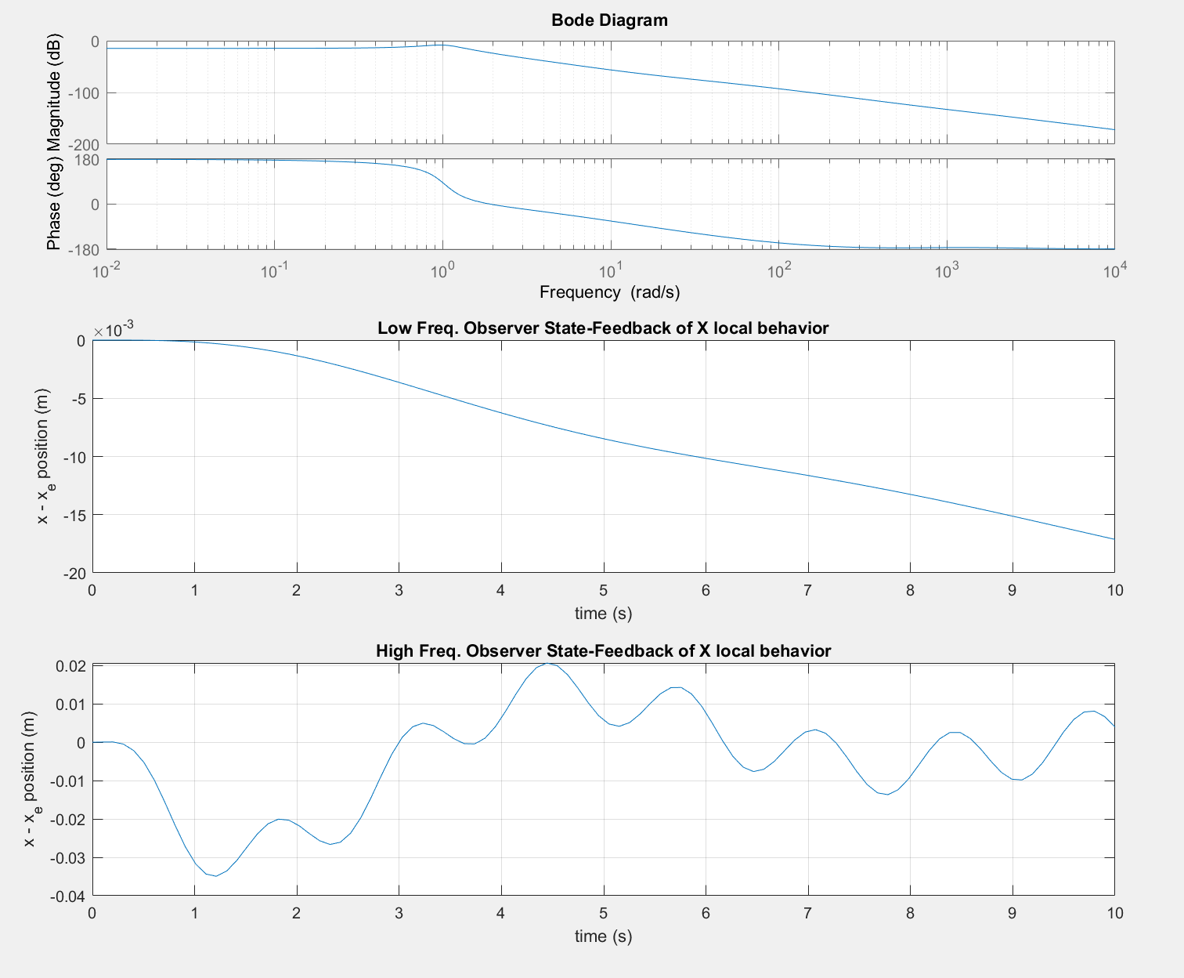
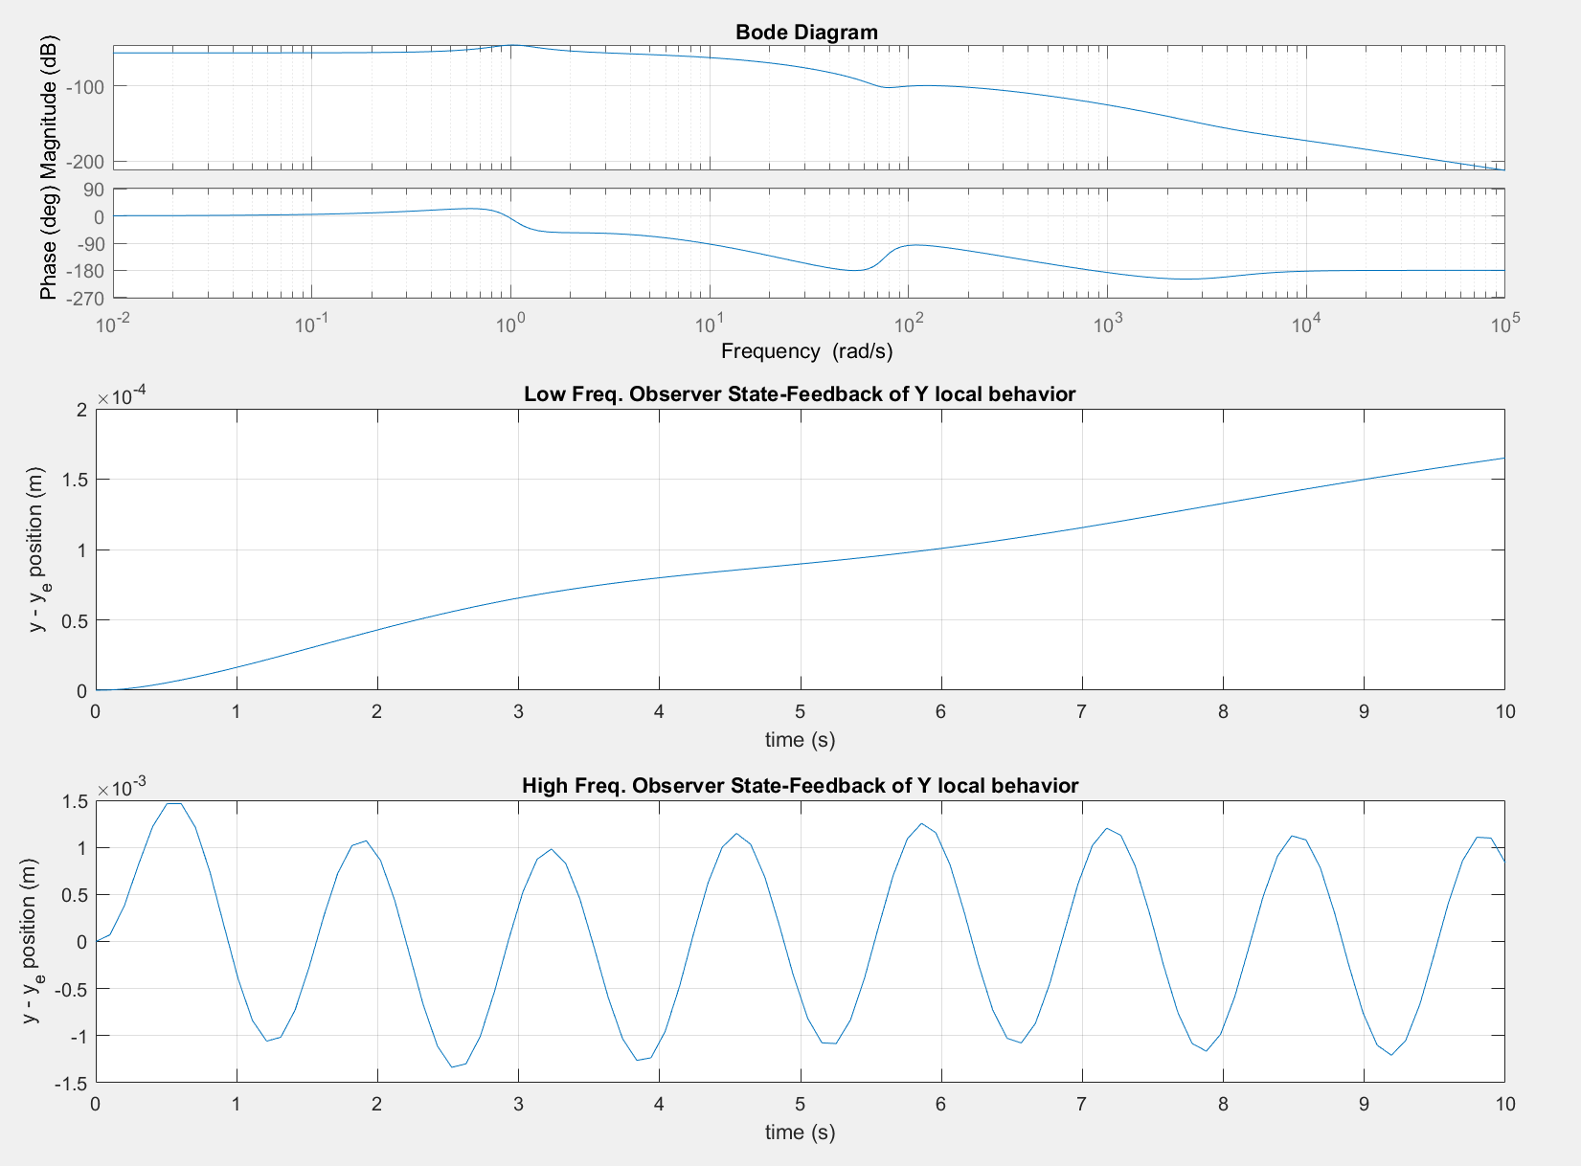
Results: Observer State-Feedback High/Low Freq. Sine
Note: Plant and Observer have no initial conditions, therefore the responses are the same.

Slide 22
Conclusion
Linearized State-Feedback & Observer State-Feedback Controller Results:
Step/Impulse: Converge to a Steady-State Value
Low & High Frequency: Converge to an Equilibrium Mean
Note: The Model neglected Air Torque Resistance but maintained controllability
Future Improvements:
Simulating Vertical Takeoff and Landing Maneuvers & External Disturbances Inputs
Implementing Nonlinear State-Feedback & Observer Controllers

Slide 23
References
[1] K. J. Åström, R. M. Murray, \textit{Feedback Systems: An Introduction for Scientists and Engineers.} Princeton University Press, 2008. [Online]. Available: http://www.cds.caltech.edu/~murray/books/AM08/pdf/fbs-public\_24Jul2020.pdf. Accessed: Feb. 10, 2024.
[2] C. S. Huang and K. Yuan.“Output Tracking of a Non-Linear Non-Minimum Phase PVTOL Aircraft Based on Non-Linear State Feedback Control”, International Journal of Control, vol. 75, no. 6, pp. 466–473, 2002. Accessed on: March 7, 2024. [Online]. Available: doi:10.1080/00207170210121907.
[3] D. Sharam, W. Gibbs, World Wide Entertainment, The Harrier Jump Jet. (2006). Accessed: Feb. 18, 2024. [Online Video]. Available: https://video.alexanderstreet.com/watch/the-harrier-jump-jet.

